Slide 1
Final Project： For CPS 1231
Presenter: Yixuan Mi
1307943
1307943@wku.edu.cn

Slide 2
Agenda
Background Information
Code Showing and Interpreting
Conclusion

Slide 3
1. Background Information

Slide 4
Background Information
CPS1231 introduces the fundamentals of computer programming techniques and demonstrates typical methods of writing concise computer programs to solve computational problems using variables and various program control structures.
In this project, I have created a menu-driven system using the knowledge gained from CPS1231.

Slide 5
2. Code Showing

Slide 6
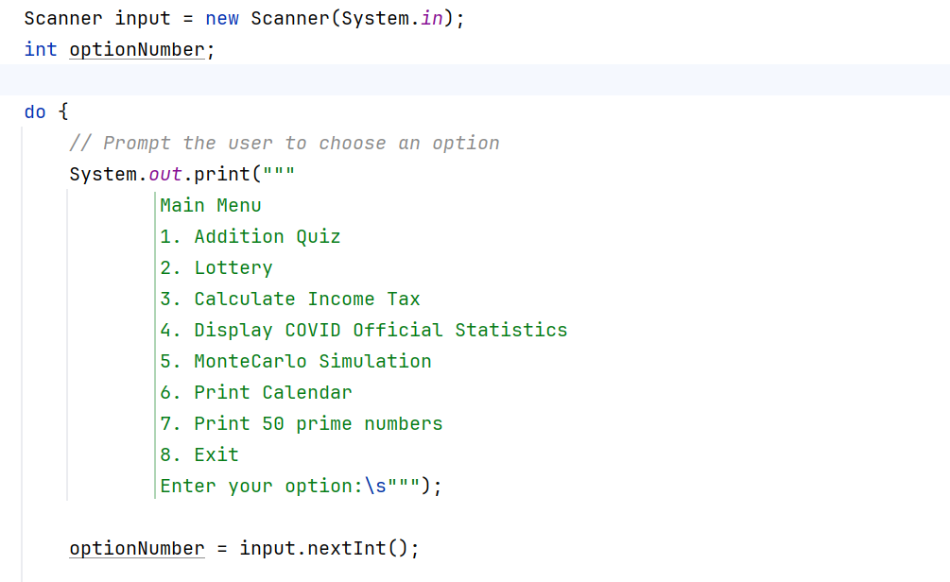
The Whole Code Frame

Slide 7
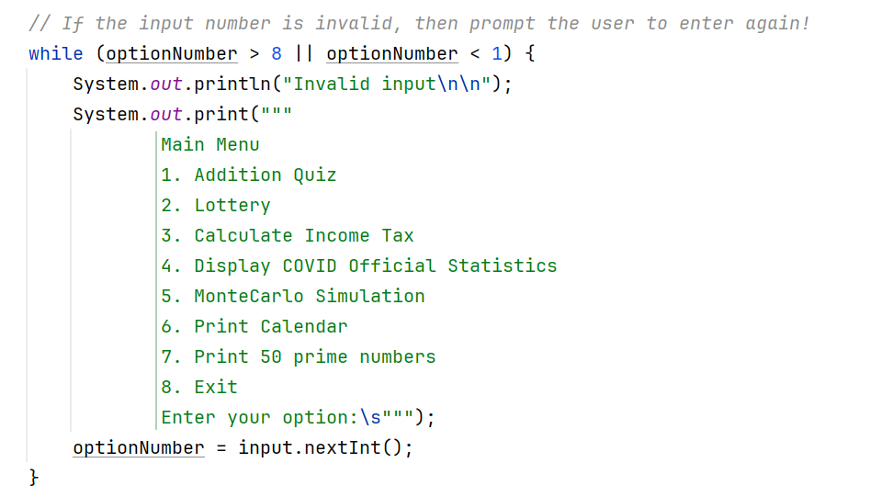
The Whole Code Frame

Slide 8
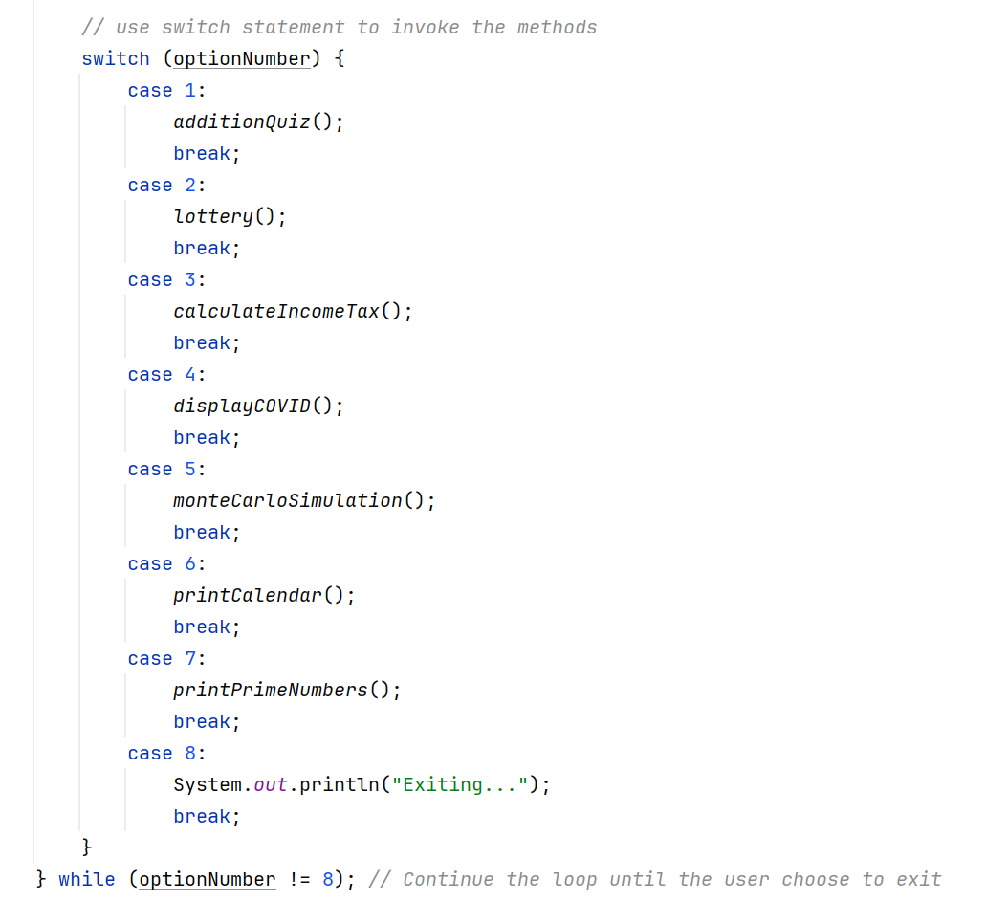
The Whole Code Frame

Slide 9
Main Menu
Addition Quiz
Lottery
Calculate Income Tax
Display COVID Official Statistics
Monte Carlo Simulation
Print Calendar
Print 50 Prime Numbers
Exit

Slide 10
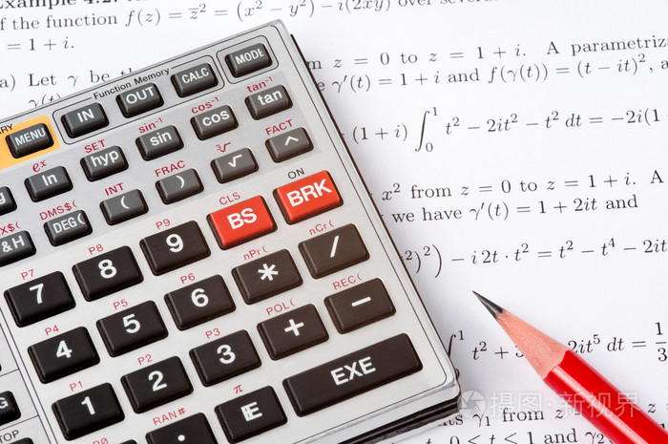
1. Addition Quiz

Slide 11
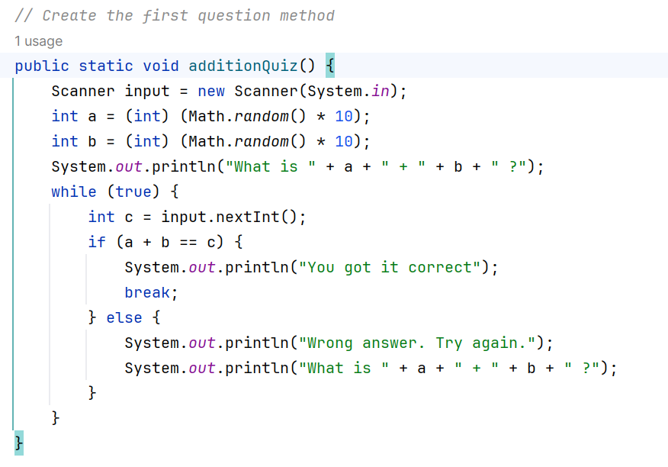
1. Addition Quiz

Slide 12

2. Lottery

Slide 13
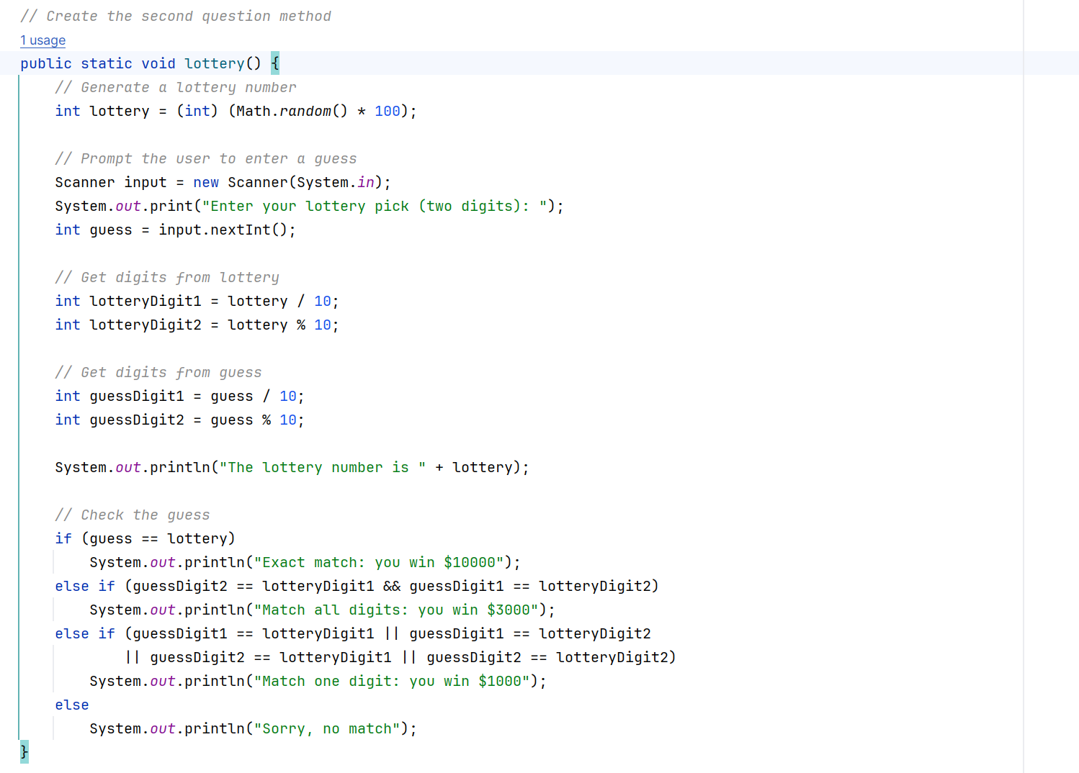
2. Lottery

Slide 14

3. Calculate Income Tax

Slide 15
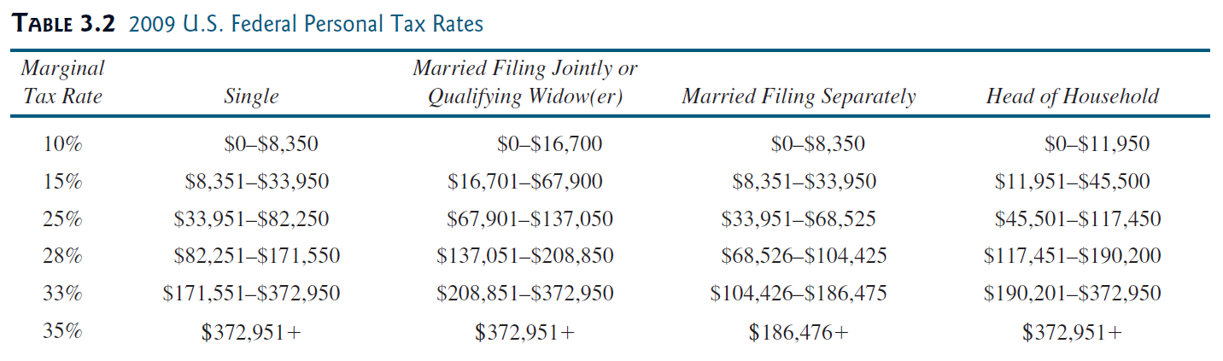
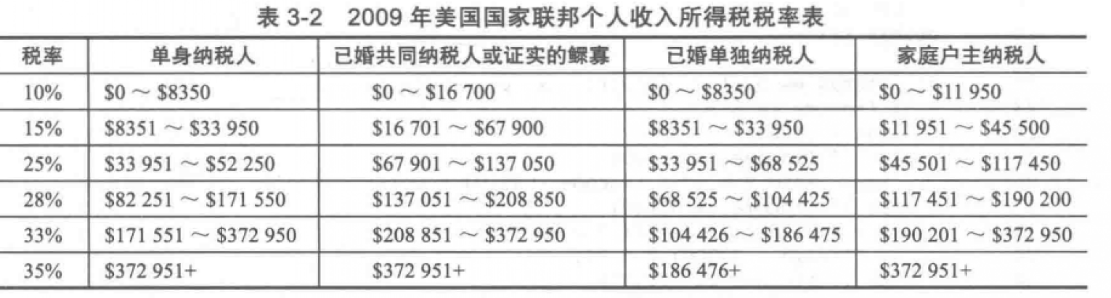
3. Calculate Income Tax

Slide 16
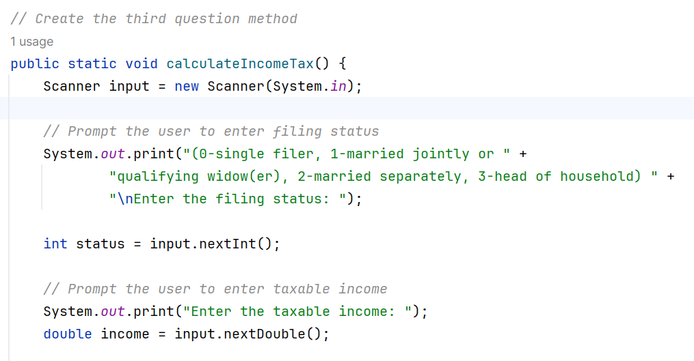
3. Calculate Income Tax

Slide 17
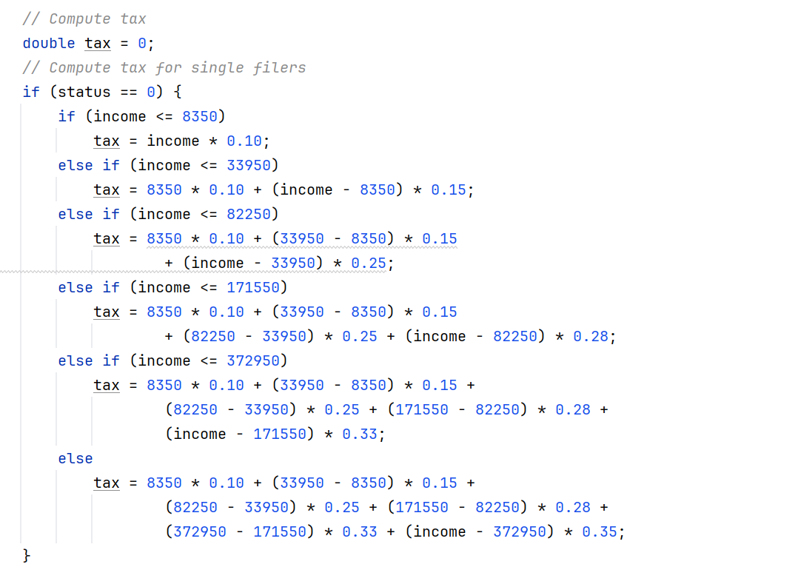
3. Calculate Income Tax

Slide 18
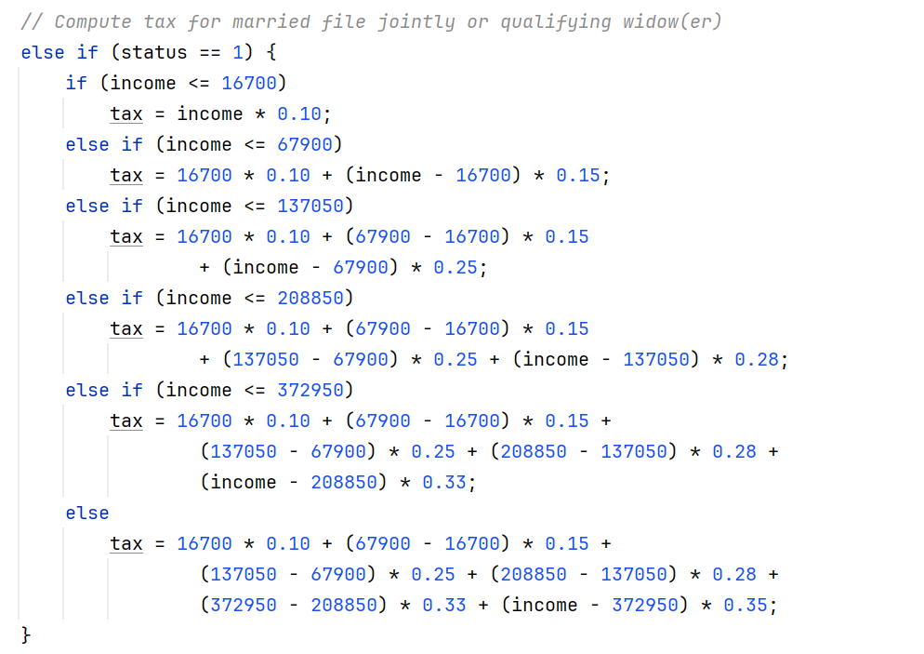
3. Calculate Income Tax

Slide 19
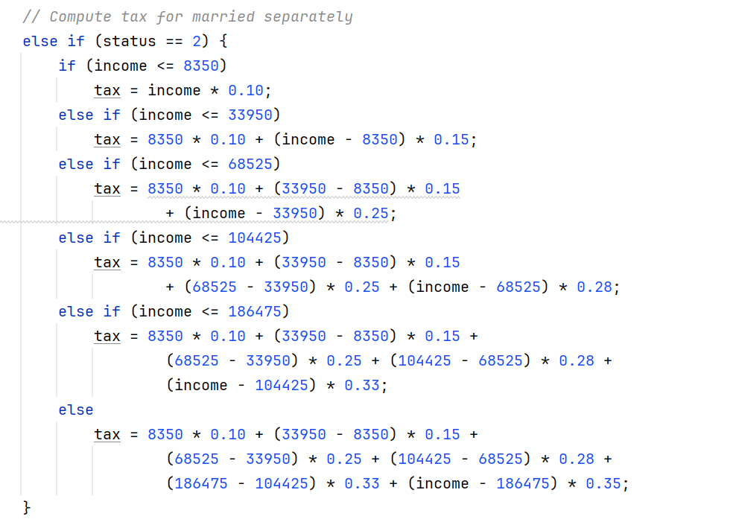
3. Calculate Income Tax

Slide 20
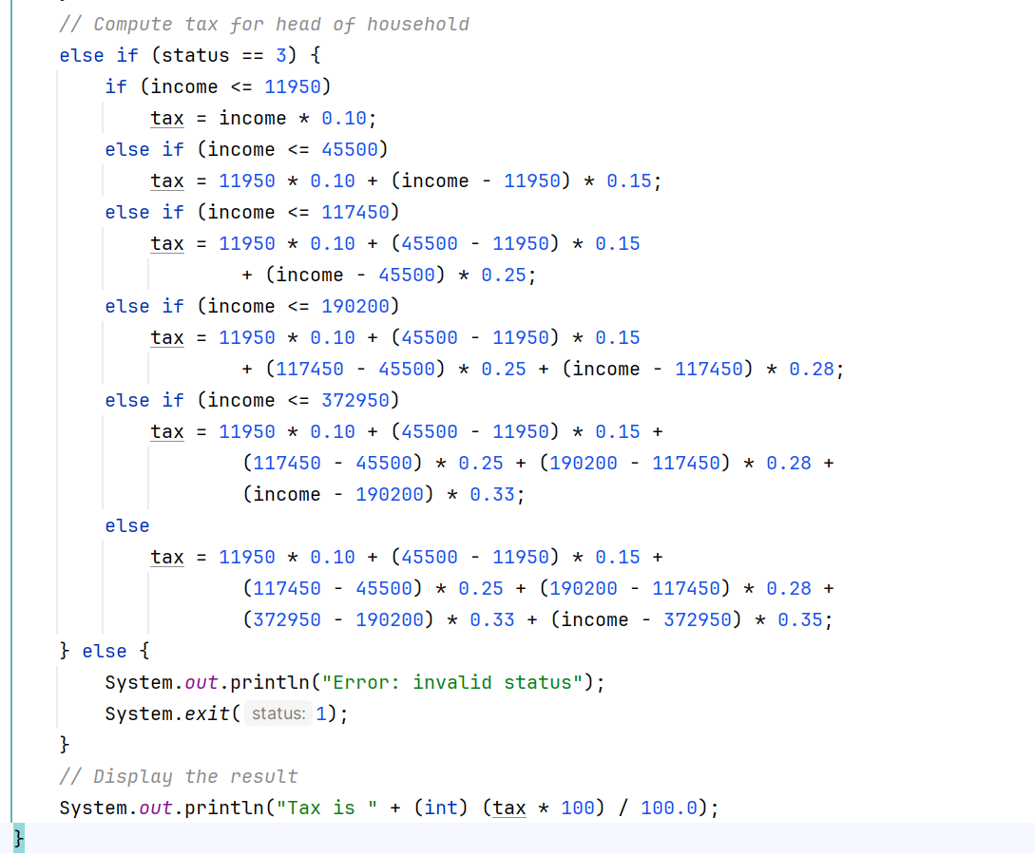
3. Calculate Income Tax

Slide 21

4. Display COVID Official Statistics

Slide 22
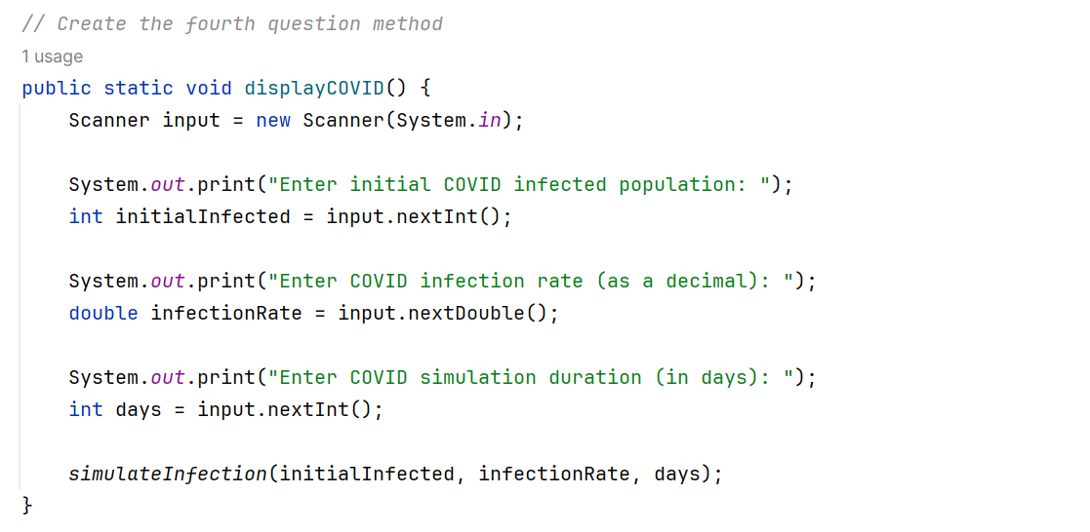
4. Display COVID Official Statistics

Slide 23
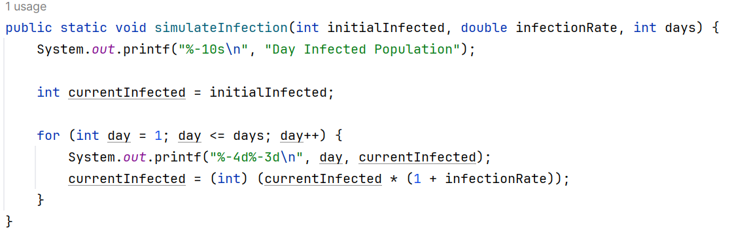
4. Display COVID Official Statistics

Slide 24

5. Monte Carlo Simulation

Slide 25
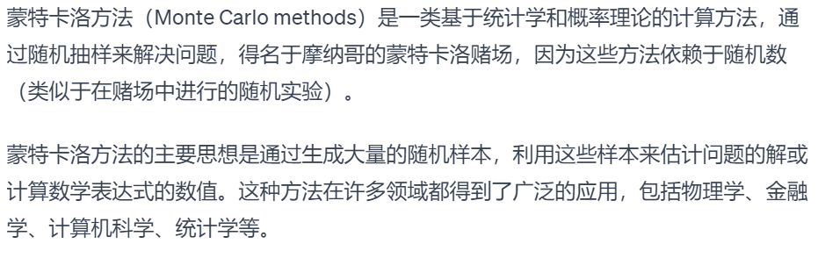
5. Monte Carlo Simulation
Monte Carlo methods are a class of computational methods based on statistics and probability theory that solve problems by random sampling, named after the Monte Carlo casino in Monaco because they rely on random numbers.

Slide 26
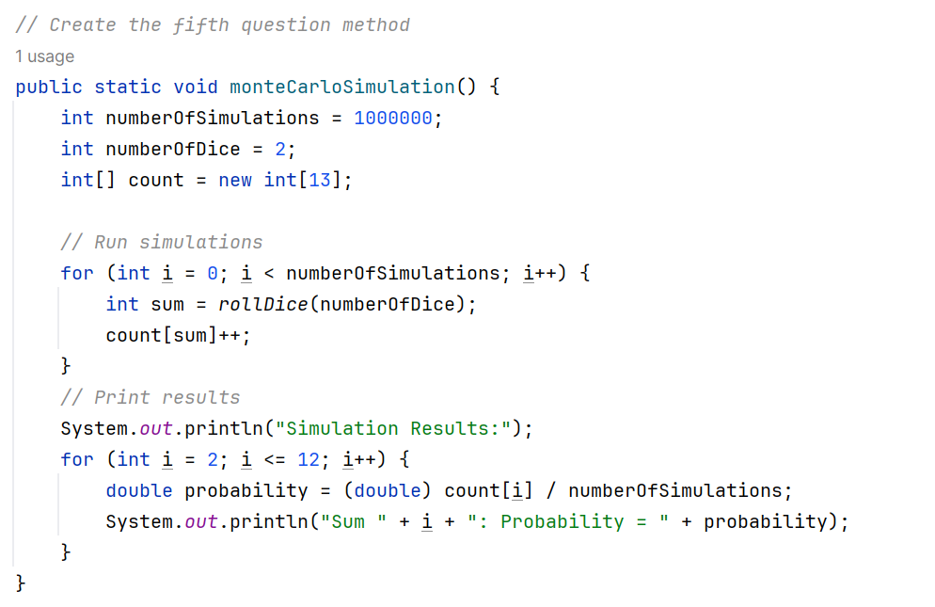
5. Monte Carlo Simulation

Slide 27
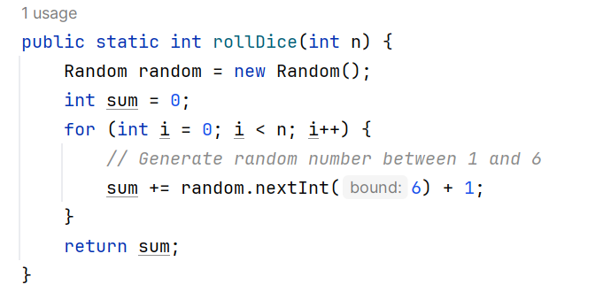
5. Monte Carlo Simulation

Slide 28

6. Print Calendar

Slide 29
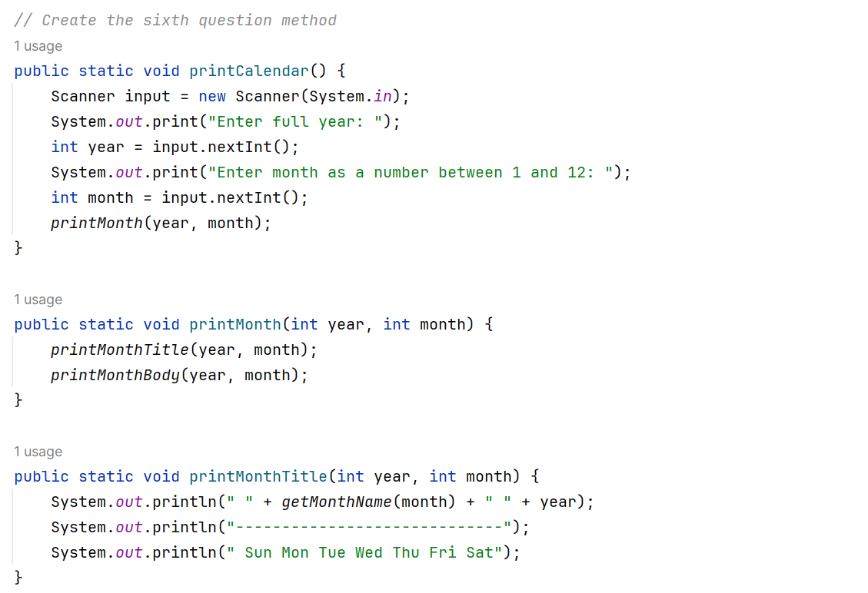
6. Print Calendar

Slide 30
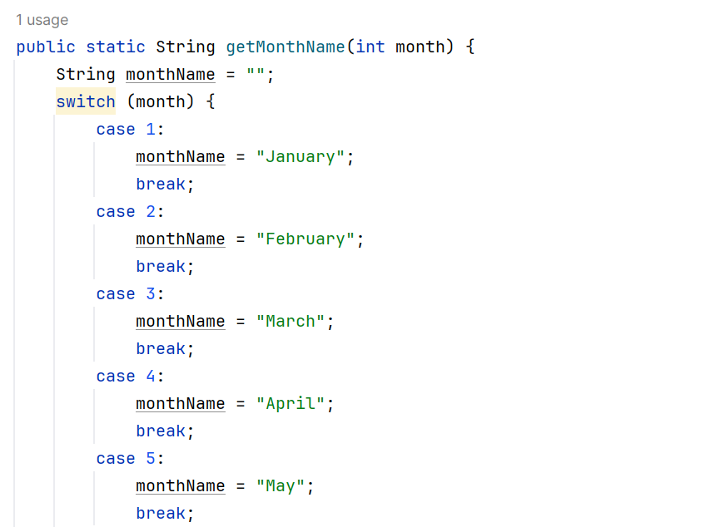
6. Print Calendar

Slide 31
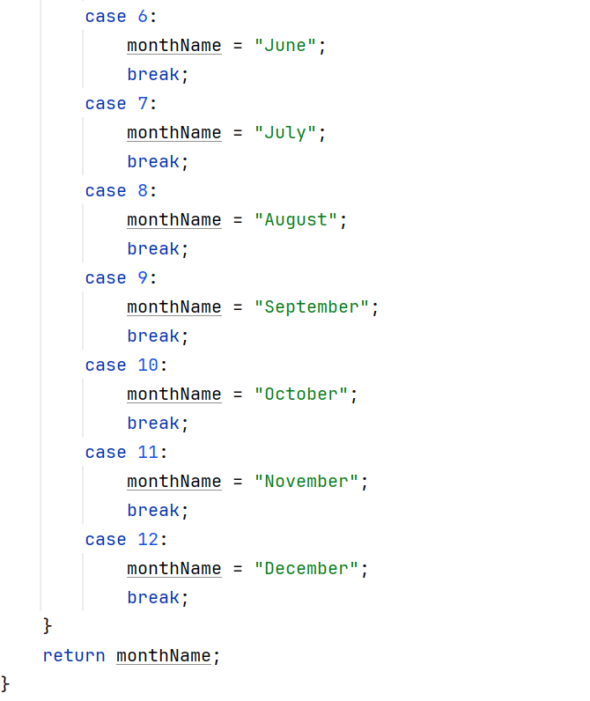
6. Print Calendar

Slide 32
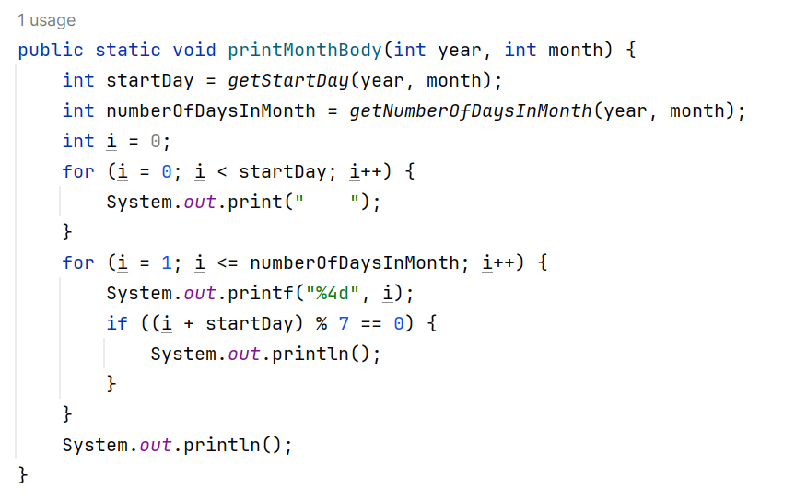
6. Print Calendar

Slide 33
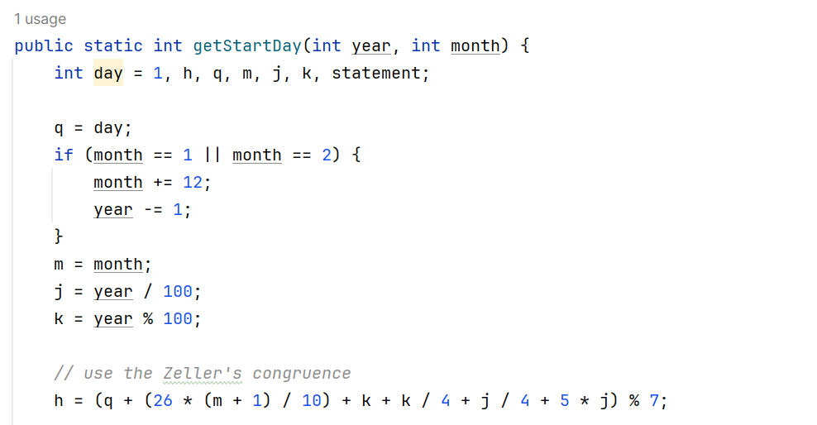
6. Print Calendar

Slide 34
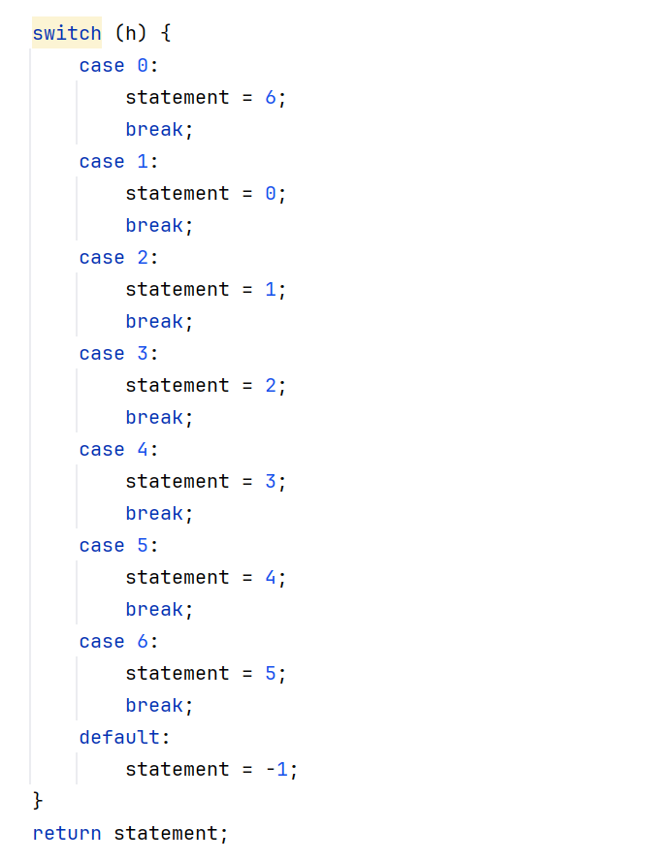
6. Print Calendar

Slide 35
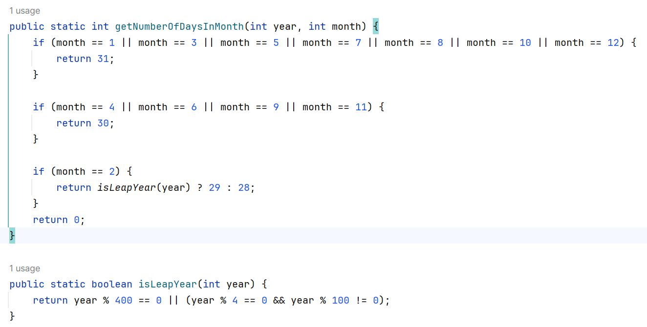
6. Print Calendar

Slide 36
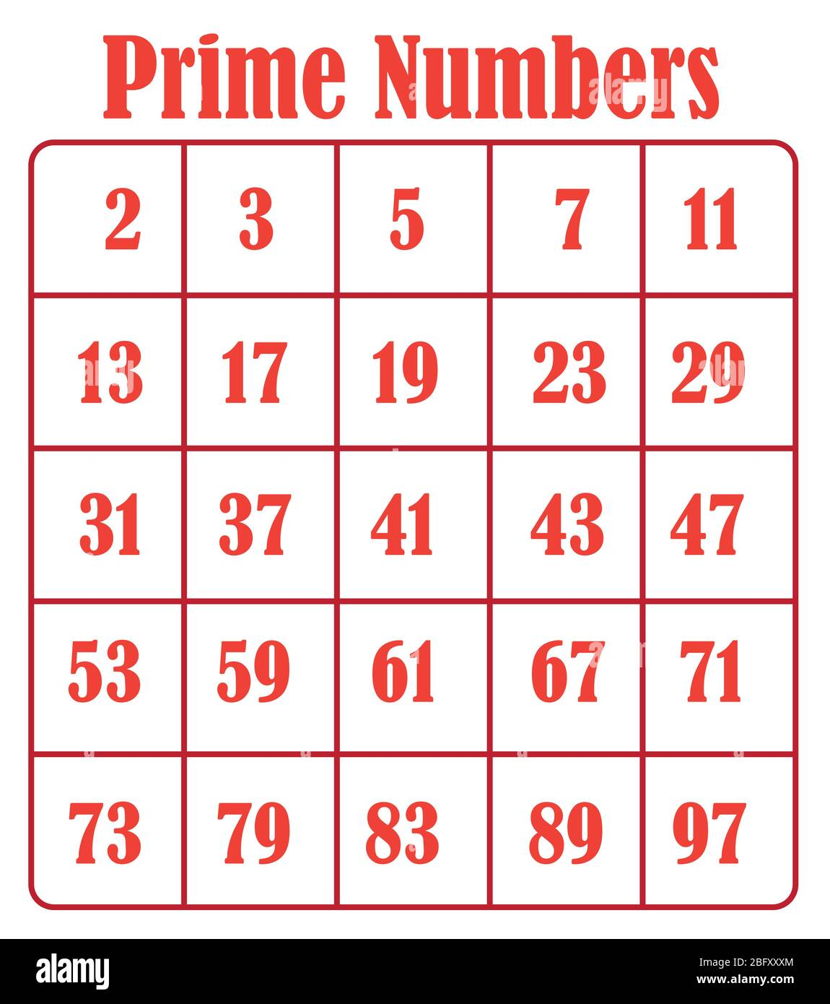
7. Print 50 Prime Numbers

Slide 37
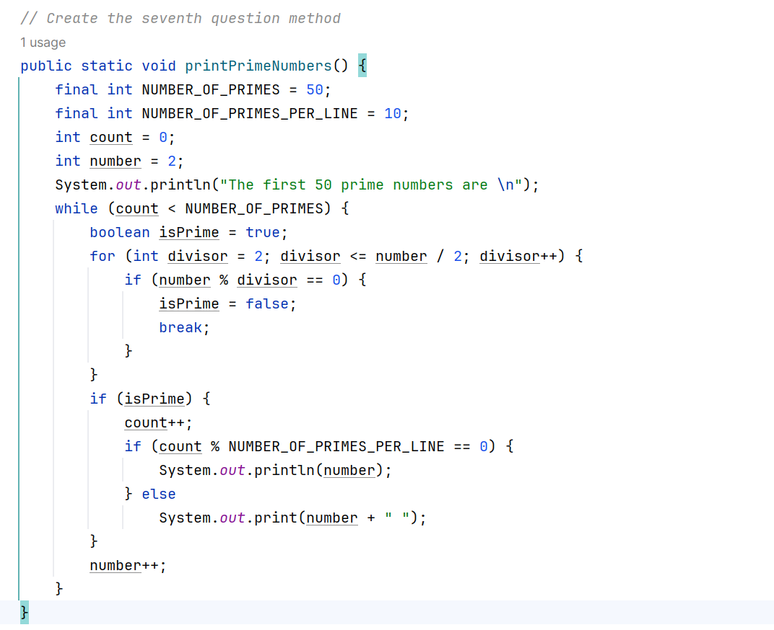
7. Print 50 Prime Numbers

Slide 38
8. Exiting
Of course, as my previous code, if you want to exit, enter number 8.

Slide 39
3. Conclusion

Slide 40
Conclusion
In my final project, I created many methods to solve eight situations. Once the user enters a valid number, my code will invoke some methods.
But as you can see, my code has many methods. It will be hard to read if I don’t make a beautiful format.
So I commented on my code; most importantly, we need to use the top–down approach frame so our code can easily be read.

Slide 41
Thank You
Presenter: Yixuan Mi
1307943
1307943@wku.edu.cn

